Slide 1
California Public Utilities Commission Energy Division Questions on General CPUC Recruitment: cpucrecruiter@cpuc.ca.gov For questions regarding energy division recruiting please contact: energydivisionrecruiting@cpuc.ca.gov

Slide 2
CPUC Overview
Mission: The CPUC regulates services and utilities, protects consumers, safeguards the environment, and assures Californians' access to safe and reliable utility infrastructure and services at reasonable rates.
Industries of Regulation
Electric utilities
Natural gas utilities
Telecommunications
Water utilities
Railroad
Rail transit
Passenger transportation companies
2

Slide 3
CPUC Overview
Governed by five Commissioners serving staggered 6-year terms, appointed by Governor and with CA Senate confirmation. Sitting Gov appoints CPUC president
Offices
~1,000 staff
San Francisco headquarters: 805 staff
Sacramento area: 63 staff, with 100 new staff planned
Los Angeles: 122 staff
Energy Division – 212 staff in all three offices
Meeting requirements
Public Voting Meeting at least once a month
Voting meetings generally in S.F., with occasional meetings in other CA locations
3

Slide 4
CPUC Energy Division
Key tasks
Approve utility rates
Oversee investor-owned electric and natural gas utilities
Policy considerations
Implement legislation
Help achieve state GHG and clean energy goals
Support system safety & reliability
Support customer choice & distributed gen
Respond to public inquiries
Support CPUC decision-making by drafting resolutions (regulations) and providing technical support for the Commission
Serve low-income and disadvantaged communities
Load Serving Entities (LSEs) & Community Choice Aggregators (CCAs) regulatory/support services
4
https://www.cpuc.ca.gov/aboutenergy/

Slide 5
Key Policies & Programs
CPUC tasked with assuring provision of safe, adequate, and reliable service at just and reasonable rates. Achieves this through policy initiatives and customer programs.
Key CPUC policy areas
Rate design
Safety Investment
Renewable and Clean Energy
Climate Change planning
Energy efficiency
Demand response (electric)
Energy storage
California solar initiative
Smart grid / Microgrid
Wildfire Safety / PSPS Events
Environmental and Social Justice
Building Decarbonization
Transportation Electrification
Customer programs and assistance
California Alternate Rates for Energy (CARE)
Low Income Energy Efficiency Program (ESA)
California Lifeline telephone
Deaf and Disabled Telecommunications Program
Telecommunications scam and fraud protection
Assistance with formal consumer complaints
5

Slide 6
CEQA
The Infrastructure and California Environmental Quality Act (CEQA) unit at the CPUC provides environmental permitting and mitigation monitoring/compliance for:
Transmission and Substation Projects
Gas Projects
Water Projects
Broadband
Rail Crossings
The primary goal of CEQA is to:
Ensure environmental consequences of decisions are meaningfully considered
Lessen the impacts of projects/actions on the environment
Provide transparency to both the public and decision-makers on what the environmental consequences may be and how those impacts may be avoided, minimized, and/or mitigated.

Slide 7
We are advancing Transportation Electrification (TE) to support California's Clean Energy Pollution Reduction Act (SB 350) and Executive Orders to ramp up zero-emission vehicles and charging infrastructure
Transportation Electrification (TE)
California faces ambitious TE goals pursuant to Senate Bill 350 and Executive Orders - to reduce greenhouse gas emissions by 50% from 1990 to 2030, and to require new cars sold in California to be zero-emission vehicles.
In response, the Public Utilities Commission's Electrification Transportation Team and other agencies have developed programs to oversee California's goals.
The TE team oversees infrastructure programs that provide subsidies and rebate structures for installing electric charging equipment and works with investor-owned utilities to expand charging stations for public use, focusing on communities with heavy pollution burdens.
The TE team helps ensure EV drivers charge at the correct times of day (by reviewing new electric rates) and is implementing strategies for integrating the load from an increasing number of EVs in a way that benefits rather than causes stress to the transmission, generation, and distribution systems.

Slide 8
CPUC has approved over $1.5 billion in funding for investor-owned utilities (IOUs) to expand the State’s electric vehicle charging infrastructure
Transportation Electrification
The chart to the right displays funds the CPUC has authorized IOUs to spend on transportation electrification investments, with approximately one-quarter of authorized ports for light-duty vehicle charging already energized.
Additionally, with the medium-duty and heavy-duty transportation sector being a significant contributor to CA's greenhouse gas emissions, the CPUC is vested in providing the necessary equipment to electrify that sector, with over 300 energized ports.

Slide 9
Integrated Resource Planning (IRP)
Established by Senate Bill 350 (De León, 2015), the objective of the CPUC’s integrated resource planning proceeding is to reduce the cost of achieving greenhouse gas (GHG) reductions and other policy goals by looking across individual LSE boundaries and resource types to identify solutions to reliability, cost, or other concerns that might not otherwise be found.
Goal of the 2019-21 IRP cycle is to ensure that the electric sector is on track to help California reduce economy-wide GHG emissions 40% from 1990 levels by 2030, and to explore how achievement of SB 100 2045 goals could inform IRP resource planning in the 2020 to 2030 timeframe.
California today is a complex landscape for resource planning:
Multiple Load Serving Entities (LSEs) including:
Investor-Owned Utilities (IOUs)
Community Choice Aggregators (CCAs)
Energy Service Providers (ESPs)
Multiple state agencies (CPUC, CEC, Air Resources Board) and CAISO.

Slide 10
Demand Response
Demand response (DR) is a way for customers to help California manage its electricity demand. DR is customers changing their electricity usage (typically reducing use or shifting use to other times in the day) at certain times in response to economic incentives, price signals, or other conditions. Future DR may involve customers increasing their electricity usage when the grid has too much electricity generation from renewable resources like the wind or sun. Effective demand response programs provide California ratepayers with various economic and environmental benefits. These benefits include:
Avoiding the construction of new power plants
Avoiding the purchase of high-priced energy
Providing greater reliability to the grid, which helps prevent blackouts
Avoiding the consumption of fossil fuels which can damage the environment
Currently, demand response programs are administered by California’s three regulated investor-owned utilities: Pacific Gas & Electric, Southern California Edison and San Diego Gas & Electric. Independent commercial entities known as ‘aggregators’ or ‘Demand Response Providers’ may also approach customers to offer DR services. Residential, commercial, agricultural and industrial customers can all participate in demand response programs and receive incentives for doing so.

Slide 11
Customer Generation
The CPUC regulates distributed generation programs and policies on both the customer and utility wholesale side of the electric meter. Customer-side of the meter distributed generation incentive programs include:
Solar on Multifamily Affordable Housing Program (SOMAH)
Disadvantaged Communities Single-family Solar Homes Program (DAC-SASH)
Self-Generation Incentive Program
These programs are overseen by the CPUC and administered through Program Administrators. Utility side of the meter distributed generation includes wholesale energy generated for sale to utilities, and these procurement programs include the renewable portfolio standard program (including competitive solicitations, feed-in tariff, and renewable auction mechanism, and other procurement mechanisms) and the combined heat and power (CHP) feed-in tariff.

Slide 12
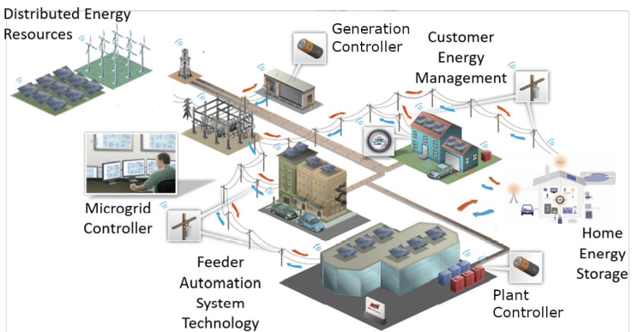
Grid Resiliency and Microgrids
A microgrid is an independent electric grid with onsite energy generation and/or storage that can operate both while connected to and when disconnected or “islanded” from the larger utility grid. Characteristics: − Has a group of interconnected loads and distributed energy resources (DER) with clearly defined, isolatable electrical boundaries − Can connect and disconnect from the grid to enable operation in both grid connected or island modes − Can act as a single controllable entity with respect to the grid

Slide 13
Energy Efficiency
The CPUC oversees and approves the ratepayer-funded energy efficiency (EE) programs.
Energy efficiency is a cornerstone of California’s energy and greenhouse gas emissions reductions efforts, and the current goal is to double the state’s 2017 level of energy efficiency by 2030.
The CPUC works with the investor-owned utilities, other program administrators (RENs and CCAs), and vendors to develop programs and measures to transform technology markets within California using ratepayer funds.
EE Programs span across the residential, commercial, industrial and agricultural sectors.

Slide 14
Energy Efficiency

Slide 15
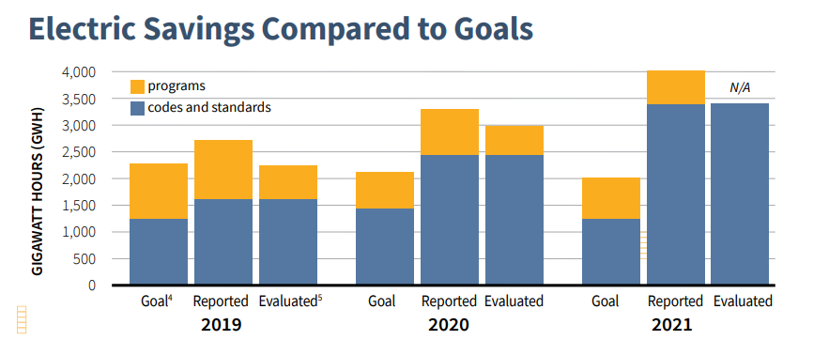
Energy Efficiency

Slide 16
Building Decarbonization and Renewable Gas Section
Building Decarbonization activity focuses on transforming the California market for high efficiency electric heat pump appliances that run off of clean renewable electricity rather than fossil natural gas.
Renewable Gas activity focuses on encouraging greater utilization of renewable gases such as biomethane, green hydrogen, and syngas as alternatives to fossil fuels.

Slide 17
Building Decarbonization Work Overview
Specific work responsibilities include:
1. Oversight of the BUILD Program, which provides incentives to builders to build new residential homes for low-income customers that are all-electric.
2. Oversight of the TECH Initiative, which provides incentives to replace gas water heaters and furnaces with electric alternatives.
3. Oversight of the San Joaquin Valley Affordable Energy program, which provides designated communities in the Central Valley with electric heat pump appliances to use in place of propane and wood fuel.
4. Oversight of the Integrated Distributed Energy Resources process and the Avoided Cost Calculator, which help determine resource allocation and cost-effectiveness for utility programs and incentives.
5. Assistance with various other programs, incentives, and initiatives relating to electric heat pump appliances and ways to encourage building electrification (e.g., energy efficiency, rates, etc.).

Slide 18
Renewable Gas Work Overview
Specific work responsibilities include:
1. Oversight of incentive programs designed to encourage biomethane production facilities.
2. Oversight of renewable gas interconnection rules, contract agreements, and health/safety standards.
3. Oversight of biomethane procurement program development and implementation.
4. Oversight of hydrogen injection standards and safety.
5. Assistance with hydrogen policy more generally across numerous different sections in Energy Division.

Slide 19
Energy Division Internships
About
University Enterprise Institute
Visit UEIJobs - University Enterprises, Inc. (csus.edu)
Take Action
Create account to apply
Email EDinterns@cpuc.ca.gov with questions
10-12 weeks, must be onsite*, paid student internships
Most Energy Division summer internship postings available through third party portal: University Enterprises Institute
Type “public utilities commission” in the keywords box to search for open opportunities
19

Slide 20
Energy Division Jobs
About
Take action
Create a CalCareer Account: https://www.jobs.ca.gov/CalHRPublic/CreateNewAccount.aspx
Review available exams: http://www.cpuc.ca.gov/jobs/
Once you pass the exam for that level, find relevant jobs in that level
Take exam for appropriate classification and level (PURA I, II,III, or V; UE*, PPS, PM, SSA, AGPA)
calhr.ca.gov
Entry, Mid level and Senior level Roles
Program Project Supervisor and Program Manager
Administrative and Support Staff
Public Utilities Regulatory Analyst (PURA)
Utilities Engineer (UE)
20

Slide 21
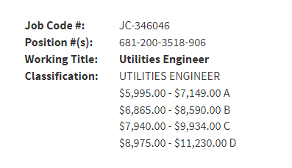
Benefits
CalPERS
Very Competitive Health and Retirement Pension Plan
Vested at 5 years*
Job Security
Civil Service Status
Public Service Loan Forgiveness Program

Slide 22
What Does the Process Hiring Entail?
For more information on energy division recruiting please visit: https://www.cpuc.ca.gov/about-cpuc/divisions/energy-division/energy-division-recruiting
Helpful links to get started:
About the CPUC (ca.gov)
Current CPUC Exams
How to get a state job
Apply for a Job information (ca.gov)
State of California Employee Benefits
How to write a Statement of Qualifications SOQ
22

Slide 23
How to Apply
Research Positions and Apply from our CPUC website (cpuc.ca.gov) or CalHR.gov
Register and apply using the “Jobs” or “Employment” link
Take the Necessary Classification Exam
If you have questions about a position or exam, contact: cpucrecruiter@cpuc.ca.gov
Or visit: cpuc.ca.gov/jobs
23

