Slide 1
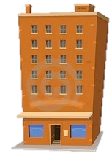
DOE’s Energy Modeling Ecosystem
Consistent
Apps
Integrated
Services
Common Platform
Efficiency
Outcomes
Reliable
Rapid
Engines
Data
Transparent
September 18th, 2015
Dr. Amir Roth (DOE/EERE/BTO)
Dr. Larry Brackney (NREL)

Slide 2
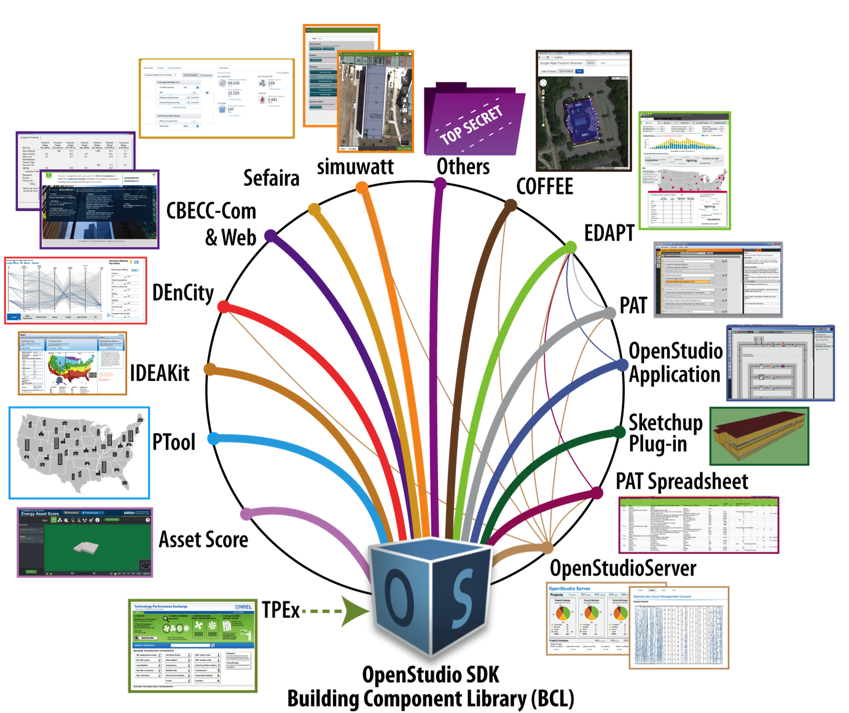


An Ecosystem: More Than an Engine or a Single Tool
Three tier architecture
Common in computer systems
Emerging in BEM
Apps: use-case specific
Open-source & publicly-funded
Or proprietary & commercial
Operating system: common abstractions
Accelerates App development
Open-source & publicly-funded
Engine: Physics Calculations
Open-source & publicly-funded

Slide 3


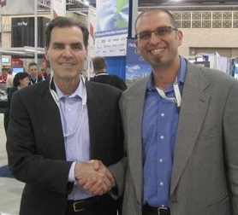


DOE’s Engine: EnergyPlus (energyplus.net)
Advanced capabilities
Heat-balance method ➔ surface temperatures, thermal comfort, radiant systems
Detailed lighting & shading, airflow within & between zones
Component-level HVAC ➔ flexible configurations, e.g., VRF & integrated heat-pumps
Sub-hourly time-steps ➔ cycling equipment, fast-acting systems, and controls
Scriptable controls ➔ demand response & occupant behavior
Co-simulation
2003 R&D 100 award winner
Modern software paradigms
Open-source, transparent, and collaborative
Migrated to C++ in 2014 (thanks Autodesk!)
Rigorous software development & test processes
Full documentation
Committed federal support
$2.5M of DOE investment annually ($65M+ to date)*
In-kind contributions from Autodesk, Trane, et. al.
Two annual updates
* Just for the engine. DOE tools investments goes much further than this.

Slide 4

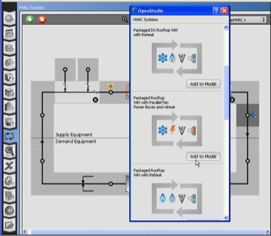
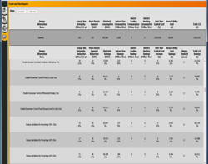
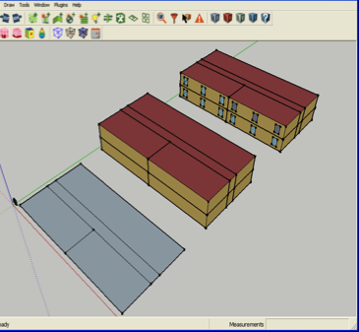
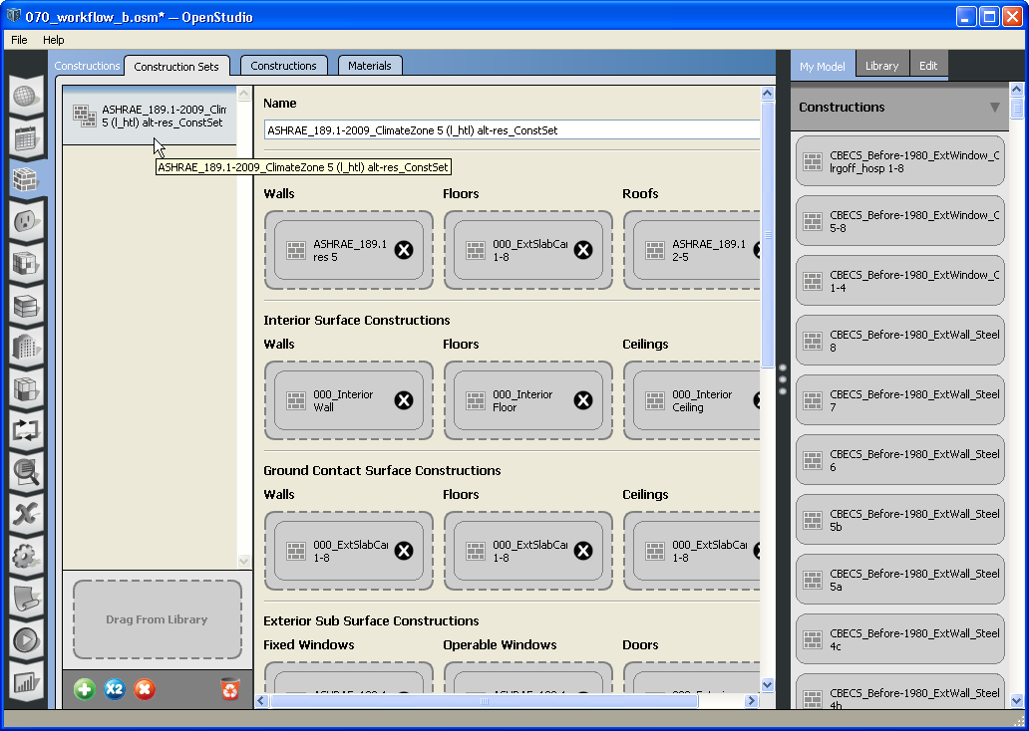
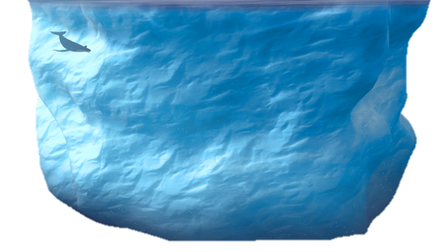


DOE’s Operating System: OpenStudio (openstudio.net)
Envelope
Constructions, loads
schedules, etc.
HVAC templates
or custom systems
Run, compare, report, QAQC, and parametric analysis
Application
Workflow-specific “skin”, demonstrates …
Scriptable API (C++, Ruby, Python, JS, C#)
Detailed
building
model
Software Development Kit (SDK)
Non-graphical “common-core” logic
  Import geometry, articulate HVAC, etc.
  Reduces application development effort
Quarterly updates
Commercial friendly open-source (of course)
$2M/yr investment from DOE & others (especially utilities)

Slide 5
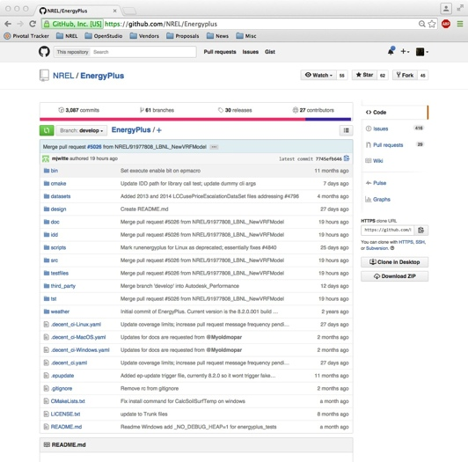
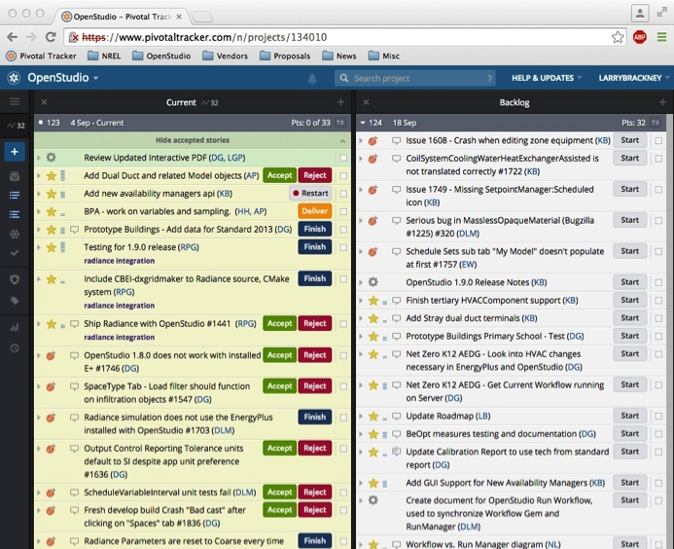
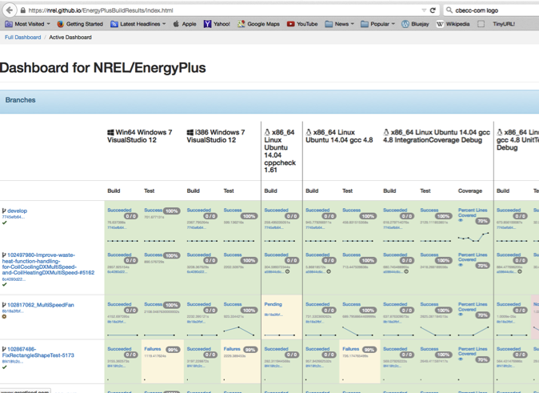
Modern, Rigorous Development & Deployment
Rigorous approach to creating production software - not a research project!
Formal source management system (GitHub)
Formal task and bug tracking systems (PivotalTracker)
Automated continuous integration (CI) tests/dashboards
Formal processes for design document and code reviews
Automated documentation generation
Bi-weekly “iteration” meetings and packages
GitHub
Benefits
Responsiveness to new requirements
Transparent & collaborative
Robust delivery
CI
Testing
Pivotal
Individual Tasks
Daily
High Priority Require-ments
Two
Weeks
Minor
Releases
Release
Features
Six
Months
CI Dashboard
Major
Releases

Slide 6
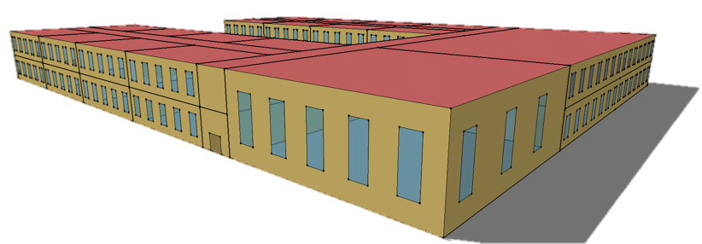
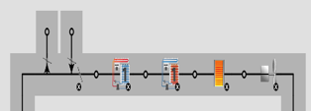

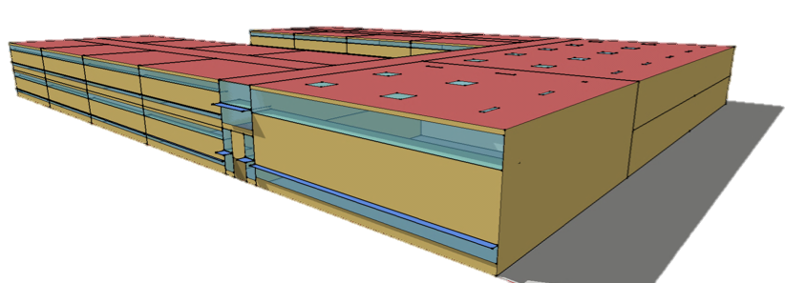
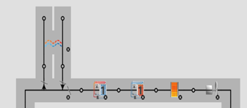
OpenStudio Killer Feature: Measures
Measures: scripts that operate on model & results
Transform model ➔ apply ECM, e.g., replace constructions, daylighting package, etc.
Can be arbitrarily surgical, e.g., daylighting measure sensitive to space-type
Perform these actions repeatedly, consistently & quickly on any model
An open way of extending functionality & transferring knowledge
Daylighting Package
Add Heat
Recovery
# Measure structure to replace exterior wall orig construction with new
model.getSurfaces.each do |s|
if s.outsideBoundaryCondition == “Outdoors” and s.surfaceType == “Wall”
if s.construction.name.get_s == orig
s.setConstruction(new)

Slide 7



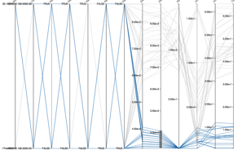

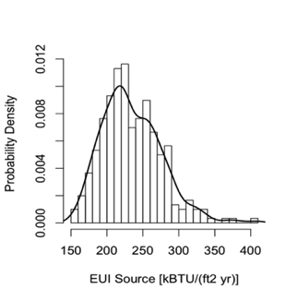

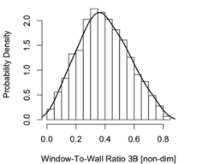
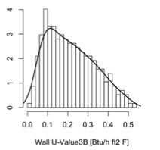
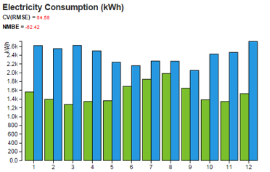
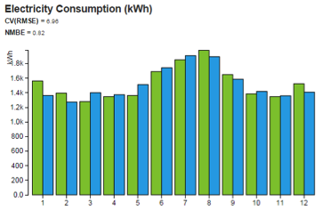

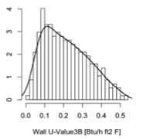
Cooking with Gas: Measures + OpenStudio Server
ECM package optimization
Measures
Outputs
Do not apply ERV
ECM
Optimizer
(EUI, ROI …)
+
ECM
ECM
If you want this site EUI
ECM
But also uncertainty analysis ➔ ranges instead of point estimates
Input parameter distributions
Output
distributions
+
+
Sampler
Chiller COP
Wall U Value
EUI
And calibration ➔ Better estimates for existing buildings
Monthly bills
Input uncertainties
Calibrated Monthly kWh
+
+
Optimizer
(Residuals)

Slide 8
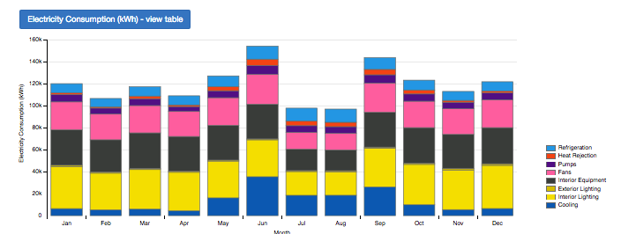
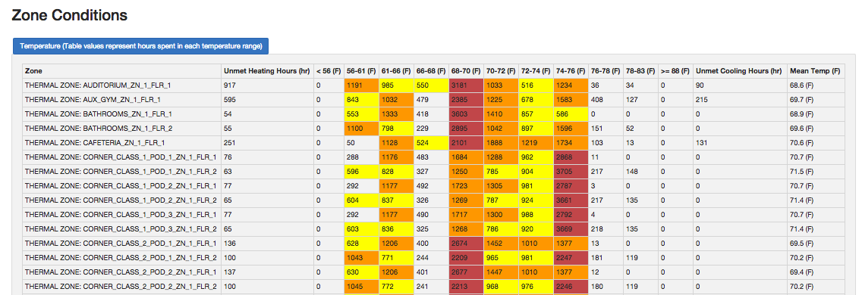
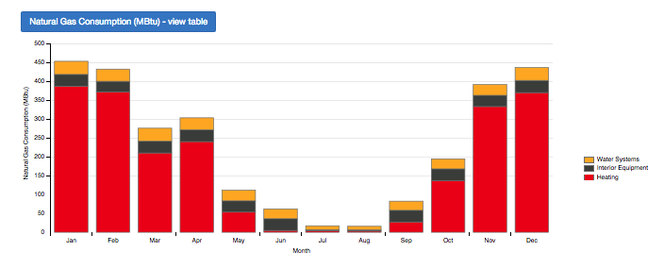
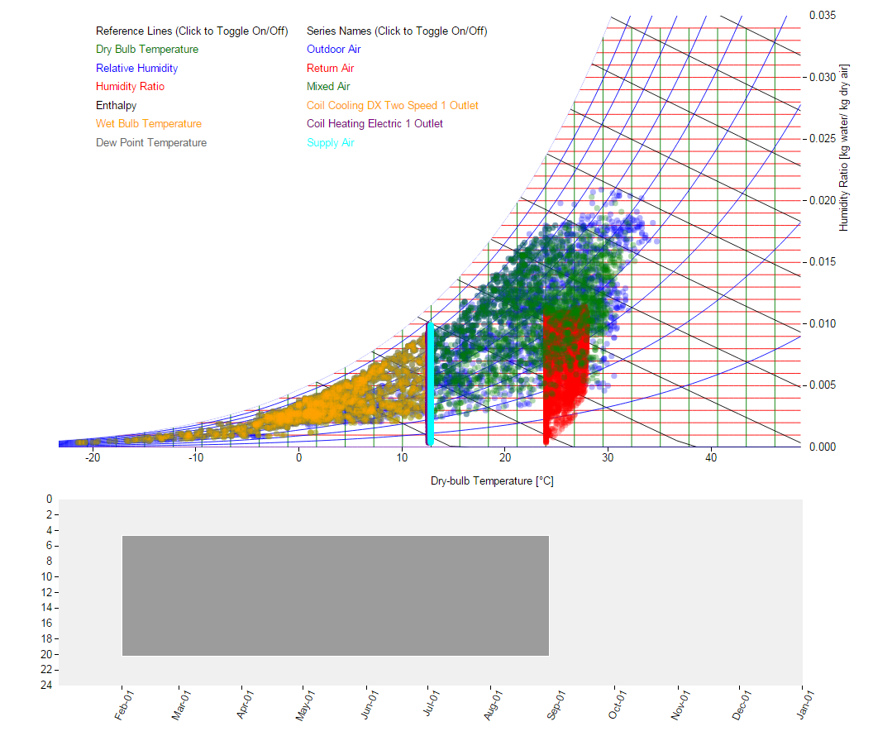
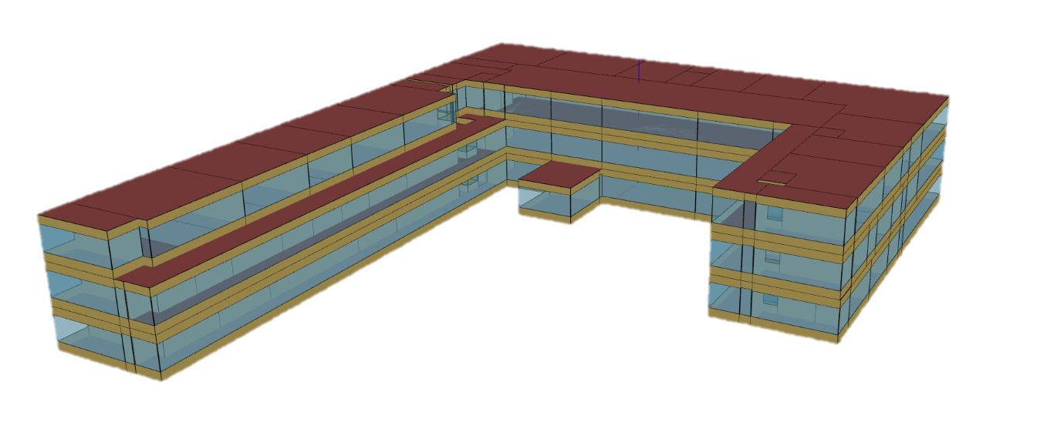
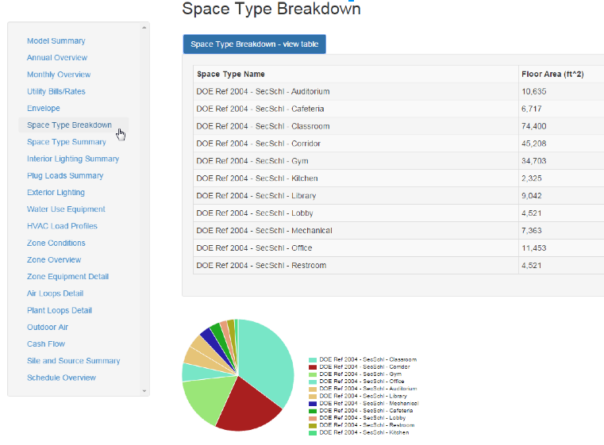
Measures Are Also for Customized Reporting & QAQC
Monthly end uses
Zone condition histogram (hrs spent in temp range)
ft² by space-type
Results Can Be
Interactive Too!

Slide 9
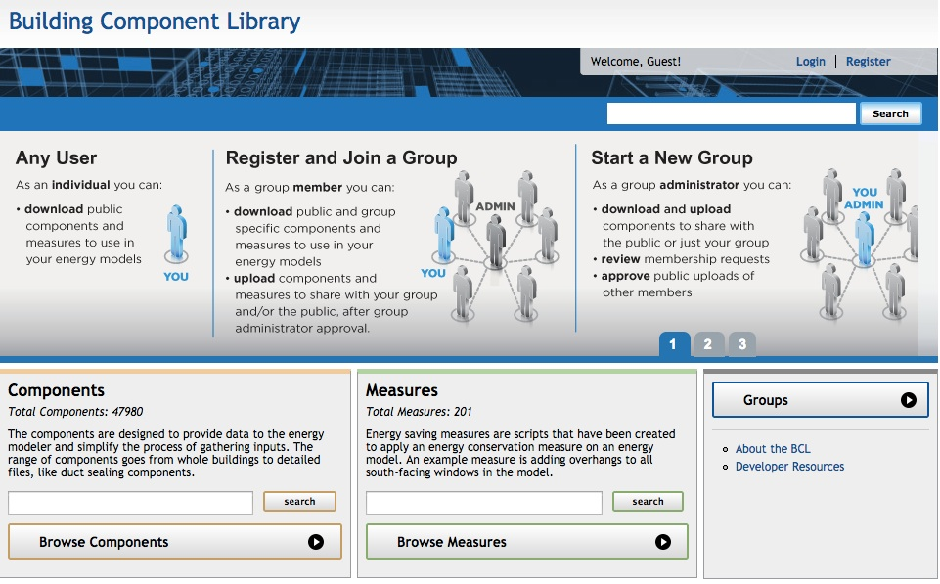
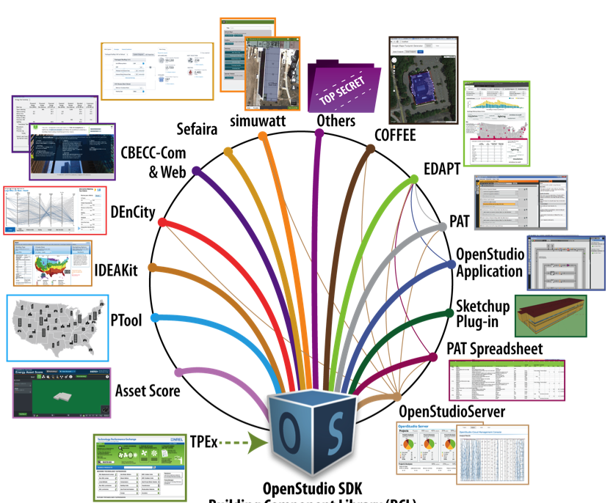
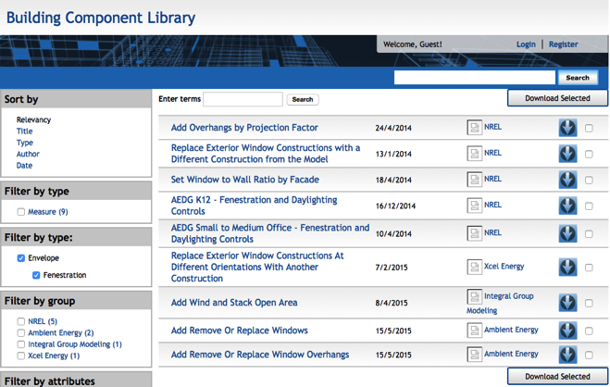
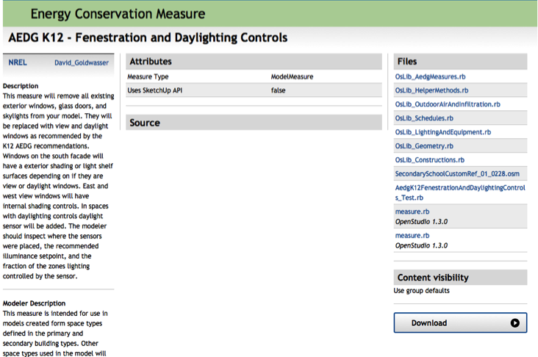
Building Component Library (bcl.nrel.gov)
Online repository of measures & other model data (e.g., schedules, weather files)
Integrated with OpenStudio SDK & applications
Supports meta-data, versioning, “group” privacy/sharing & API
Use in any OpenStudio app
Browse & search on web or in app via API

Slide 10
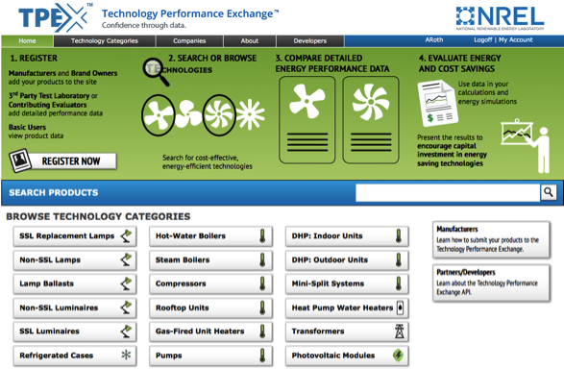
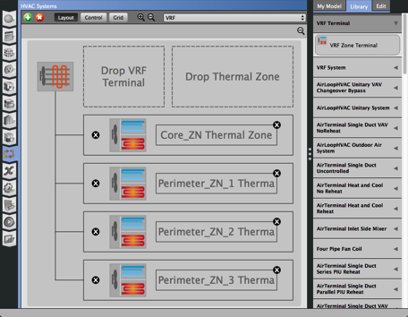
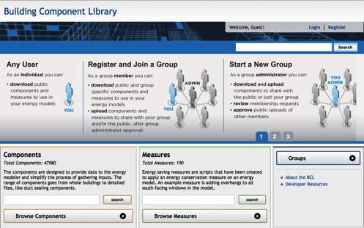
Technology Performance Exchange (tpex.org)
Provides OpenStudio ecosystem with component-specific data path
Equipment performance data from manufacturers, M&V’ed demos & pilots
Automated translation to BCL performance data for use in OpenStudio-based tools
Good source for uncertainty distributions ➔ Can complement and cross-check sims
Use in any OpenStudio app
Raw performance data automatically converted into BCL objects

Slide 11
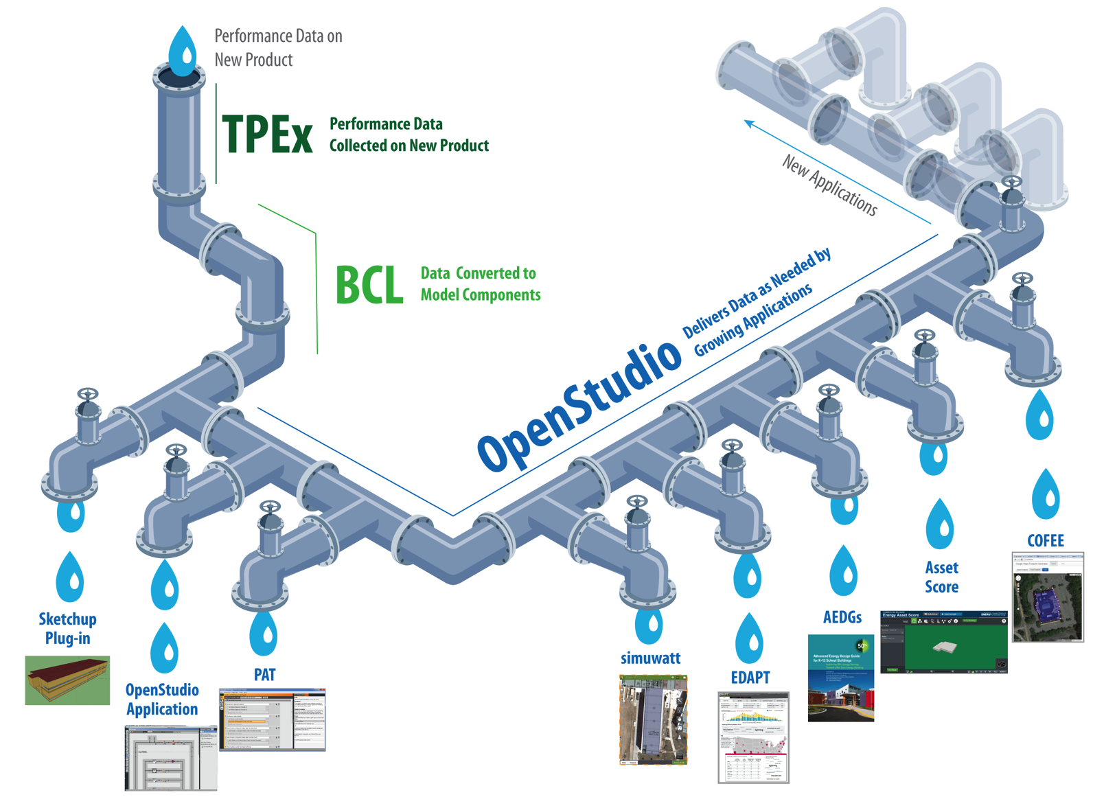



A Relevant Ecosystem Example
COFFEE
CBECC-Com &
CBECC-Web

Slide 12
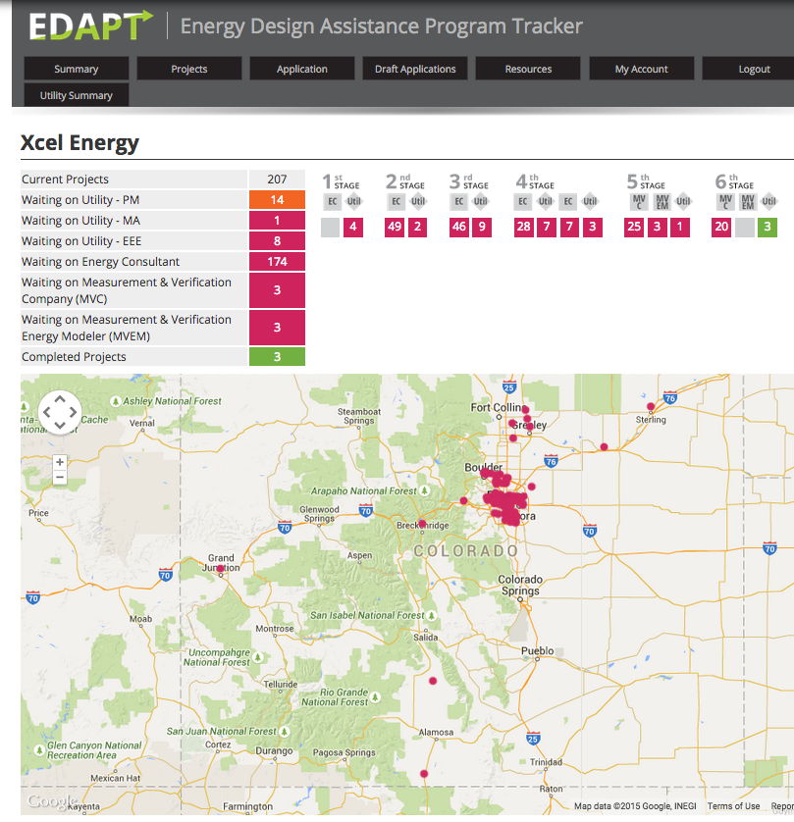

EDAPT: Savings-By-Design Program Tracker
http://eda-pt.org
Software-guided workflow
Automated:
  Notifications
  Quality checking
  Reporting
  Portfolio roll-ups
Integrated with OpenStudio
Can be integrated with other tools
Developed for Xcel Energy
  Saved $500k in program admin costs in 1st year of operation
  Grew from 2 consultants to 10
  Significant increase in number of projects processed annually
Now available to other utilities

Slide 13
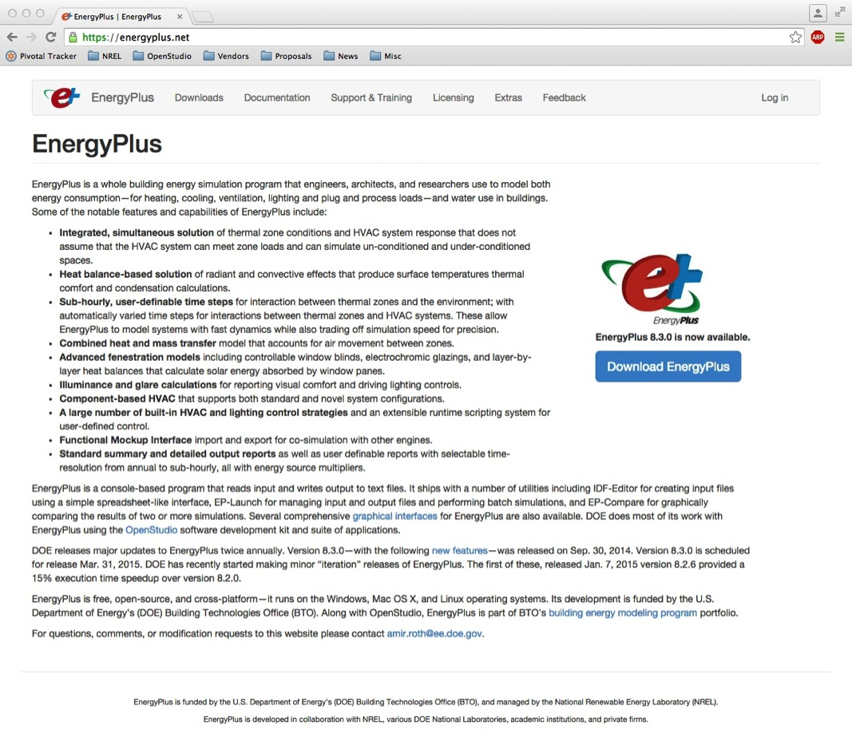
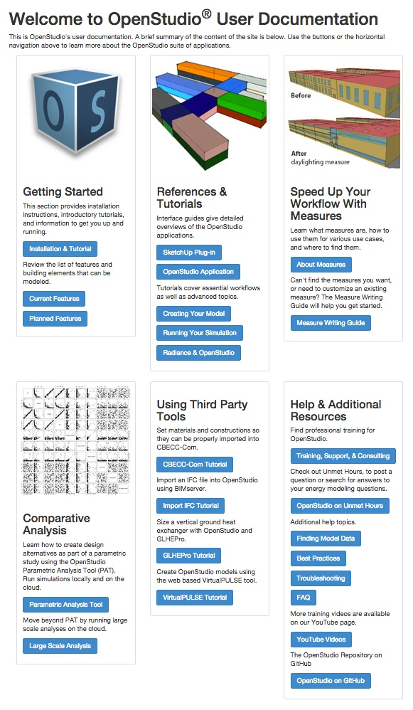
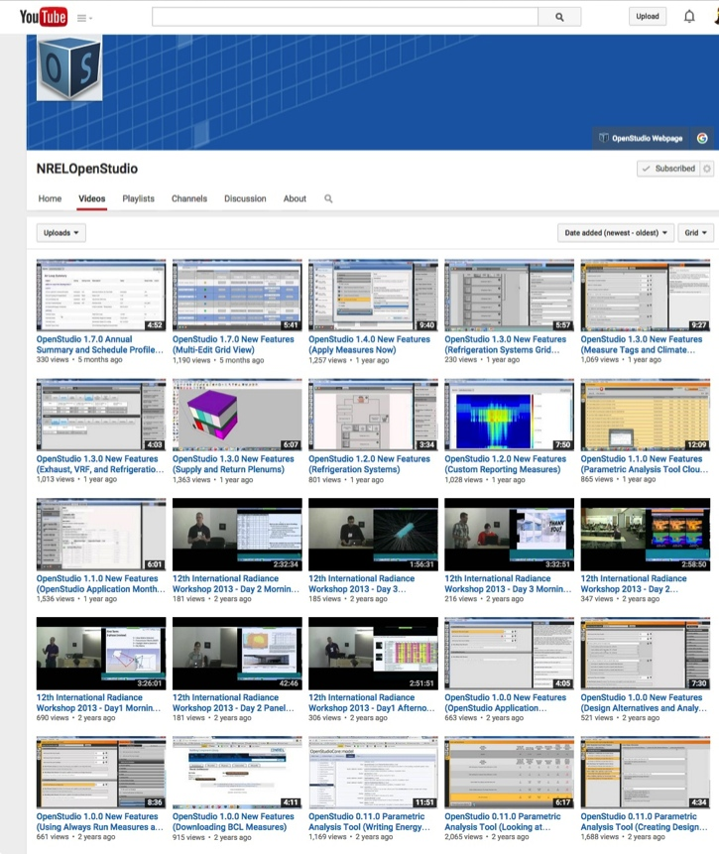
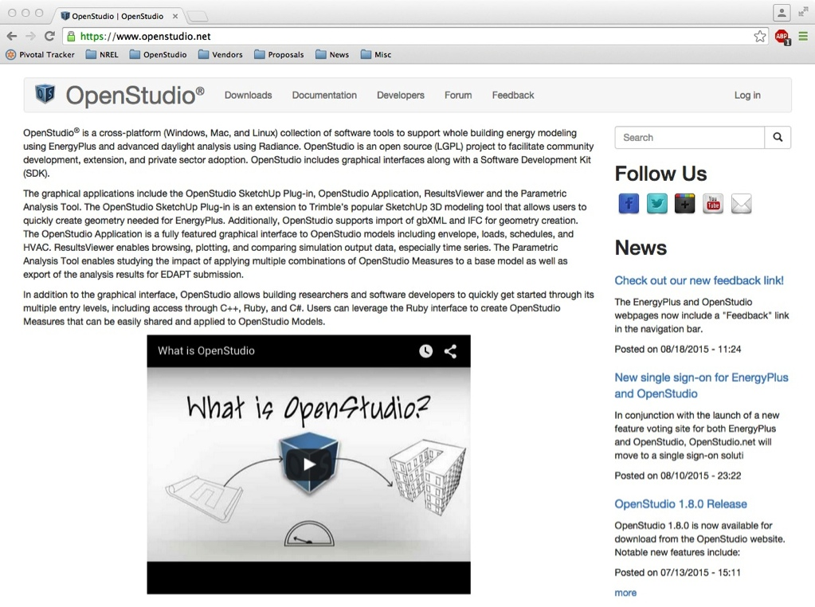
Ecosystem: Online Reference & Learning Resources
http://energyplus.net/
http://openstudio.net/
Downloads & example files
Training videos & step-by-step tutorials

Slide 14
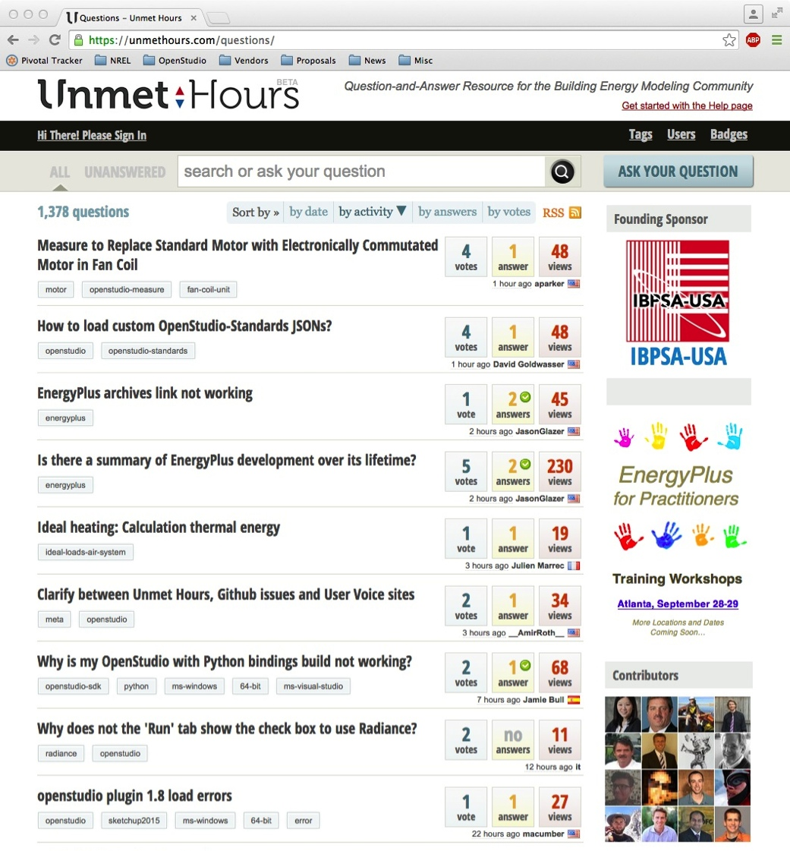
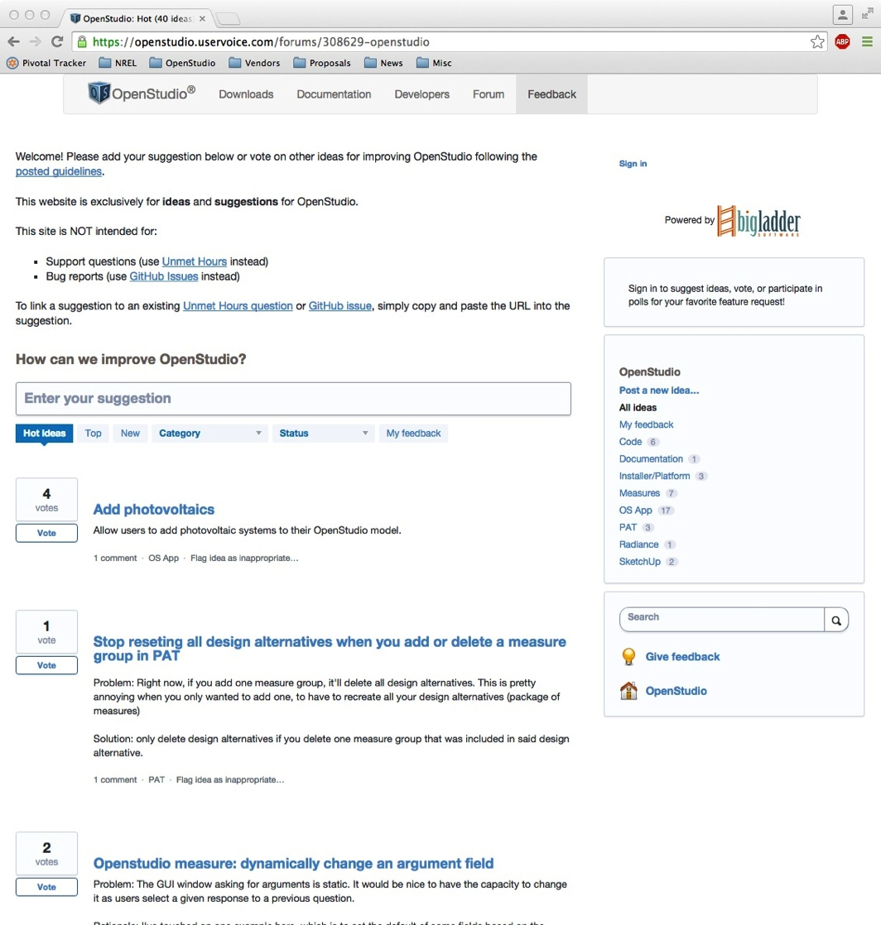
Ecosystem: Online Q&A and Feedback Resources
http://unmethours.com/
http://energyplus.uservoice.com/
http://openstudio.uservoice.com/
Peer-to-peer Q&A site
800+ users, 150+ questions/month
Development teams and users active
User feedback sites
New feature proposal, discussion & voting

Slide 15
Key Strengths of the DOE Ecosystem
EnergyPlus’ Advanced Modeling Capabilities
Correctly models physics and technologies needed to achieve high efficiency targets
Commercial-Friendly Open-Source
  Transparent source code, reference data & engineering assumptions
  Transparent development process & roadmap
  Enables and accelerates market innovation
"Free software is a matter of liberty, not price… think of free as in free speech, not as in free beer.”
- Richard Stallman

Slide 16
Key Strengths of the DOE Ecosystem
EnergyPlus’ Advanced Modeling Capabilities
Commercial-Friendly Open-Source
Cost-Shared, Continuous Development
DOE invests heavily to maintain the platform as a public good
Third-parties are augmenting this investment
  Autodesk C++ conversion
  Trane and Carrier in-kind HVAC improvements & validation
  Utility investment in OpenStudio, EDAPT & measure content
EnergyPlus Budgets
OpenStudio Budgets

Slide 17





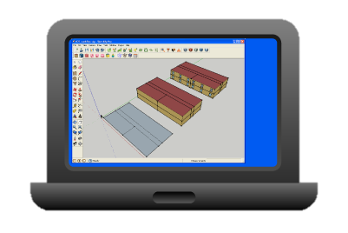
Key Strengths of the DOE Ecosystem
EnergyPlus’ Advanced Modeling Capabilities
Commercial-Friendly Open-Source
Cost-Shared, Continuous Development
OpenStudio Measures Are Now a Common Currency
Codifies and distributes best practice
Enables automation for lower cost & greater reliability
Many firms are now able to add capability to the ecosystem
Thanks!
Ich bin expert!
Help!

Slide 18

Key Strengths of the DOE Ecosystem
EnergyPlus’ Advanced Modeling Capabilities
Commercial-Friendly Open-Source
Cost-Shared, Continuous Development
OpenStudio Measures Are Now a Common Currency
Scalable solution for big problems
  Design optimization
  Calibration
  Uncertainty and sensitivity analysis
  Portfolio-scale potential studies & EE Targeting
Reference
Models
EE Measures
Tech Potential
Analysis
Custom
Analysis
Identical Assumptions &
Modeling Approaches

