Slide 1
Panel Discussion on Building Energy Modeling
Joe Huang
White Box Technologies, Inc.
Moraga CA USA
CPUC Workshop
San Francisco
September 18, 2015

Slide 2
Questions posed to panel
How do modeling experts validate models?
Are there some tool features that facilitate understanding of underlying calculation methods, inputs, and outputs?
How do experts and non-experts understand whether an output is reasonable?
How do people who aren’t building modeling experts understand what is accurate?
What can be done to account for user error, if anything?

Slide 3
How do modeling experts validate models?
Different models serve different purposes, and require different approaches for their validation.
If the model is a prototypical building, such as the DEER building models, the building and system characteristics should be representative of the building stock , and their energy usage should be calibrated to the mean energy use from surveys or data bases.
If the model is of a specific building or project, it should then reflect as closely as possible the building as-built and as-operated; if it’s an existing building, the model should be simulated with the actual weather and then calibrated to the utility bills.
What are the key parameters to get right?
EnergyUse? Energy Savings for Measures?
Total Peak Load Reductions for Measures ?

Slide 4
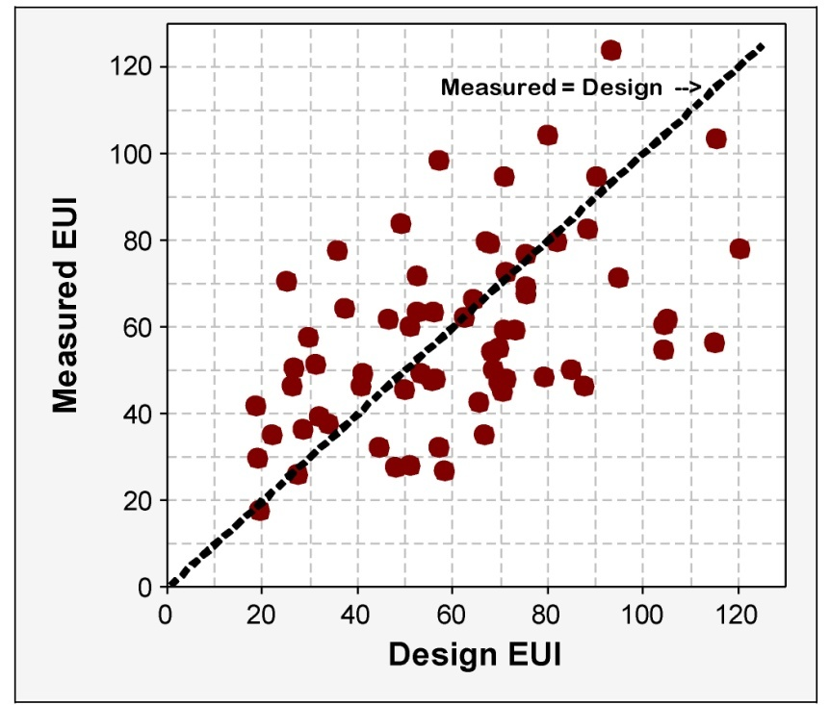
How do modeling experts validate models?
Many studies have found that the largest contributor to differences between measurements and simulation results are not the algorithms, but the input assumptions.
Measured versus design (simulated) EUIs for 121 LEED NC buildings
(Turner and Frankel, NBI 2008)

Slide 5
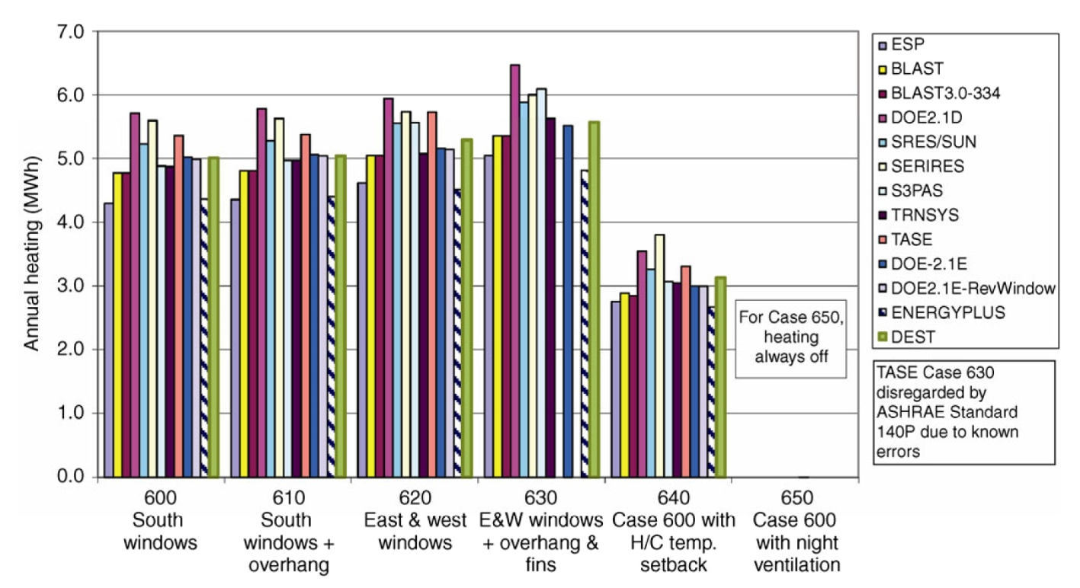
How do modeling experts validate models?
ASHRAE Standard 140 has routinely compared many simulation programs, but does not pass judgment on their relative merits
Annual heating loads for the 600 series low-mass tests from ASHRAE Standard 140-2007
(Zhu et al. 2013)

Slide 6
Are there some tool features that facilitate understanding of underlying calculation methods, inputs, and outputs ?
All of the tools with which I'm familiar have similar transparency about their underlying calculations, and input/output features.
For example, in DOE-2 if Diagnostic Comments is turned on, all the inputs used by the program are listed and identified as Default or User-Input; in the Compliance Option of eQUEST, the different types of inputs are also color-coded.
The DOE-2 input processor (doebdl) provides three levels of diagnostics – cautions, warnings, and errors – and highlights in the input echo where they occur, which is very useful for rapid debugging of input files.
DOE-2 output files are a combination of standard monthly reports and user-customizable hourly reports.

Slide 7
How do experts and non-experts understand whether an output is reasonable?
This is a difficult question to answer, especially when pertaining to a non-expert, because much depends on the person’s familiarity with building construction and operations.
For experts, there are many sources of information on typical building characteristics, Energy Use Intensities (EUIs), and component loads (proportion of space conditioning energy use attributable to walls, windows, roof, internal gains, etc.) that can be used to evaluate whether an output is reasonable.
However, care needs to be taken to avoid “false positives”, situations where an unusual energy usage pattern may actually be correct.
Whenever possible, “back of the envelope” calculations using first-principle should be done to confirm computer simulation results.

Slide 8
How do people who aren’t building modeling experts understand what is accurate?
The most important fact that should be pointed out to non-experts is not to have unrealistic expectations of the accuracy of building energy simulations.
Computer simulations are good tools for understanding the combined effects of multiple thermal processes on building energy use, but they are not magic potions for predicting how building are used or operated.
The biggest source of error between simulations and actual performance are the differences between how the buildings are modeled and how they are actually used.
Computer simulations are best for calculating the relative change due to energy measures than the absolute energy use of a building.

Slide 9
What can be done to account for user error, if anything?
“User error” can occur for a variety of reasons – differing modeling rules, input assumptions – in addition to mistakes in creating the building model or modeling the energy efficiency measure.
The best way to minimize “user error” in the software is to make the modeling rules as comprehensive and explicit as possible, and the user inputs transparent and traceable.

