Slide 1
R. 13-12-011: Track 3
Water Energy Nexus
Calculator 2.0 Workshop
April 6, 2016
Elise Torres, TURN
etorres@turn.org

Slide 2
Limitations of the Calculator
The current water-energy calculator tool is of limited use and function due to its inability to:
Evaluate gas embedded energy savings,
Consider site energy savings and benefits, and
Delineate between long-distance water conveyance upstream of carry-over storage, from the energy used to convey water from carry-over storage to end-users

Slide 3
Summary of Recommended Changes to the Tool & Expanded Uses
Include default gas energy-intensity values
  Expand the Water-Energy Calculator to include site energy savings and benefits
  For expanded use of the Calculator by other entities, the energy used in long-distance water conveyance to carry-over storage should be excluded

Slide 4
Include Gas Default Energy Intensity Values
Default gas energy intensity values are needed to evaluate gas-related embedded energy savings from water savings
These values are necessary to determine the amount of gas used in water and wastewater collection, treatment, and distribution
  Will allow for a better understanding of gas-related embedded energy savings from water savings

Slide 5
Include Site Energy Savings
Currently not possible to evaluate the costs and benefits of site and embedded energy savings from an energy ratepayer perspective.
  The EE cost-effectiveness calculator includes only site energy savings and the W-E calculator includes only water avoided costs with embedded energy savings
Change is necessary to allow for:
  Straightforward evaluation of proportionality &
  Consideration of cost effectiveness from an IOU energy ratepayer perspective based on site and embedded energy savings benefits

Slide 6
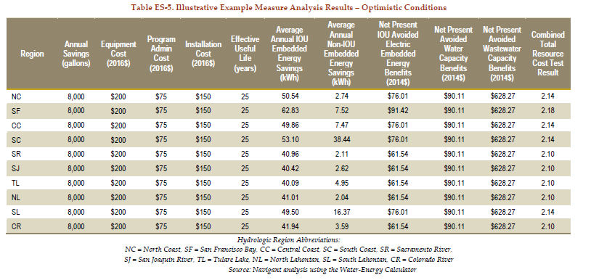
Illustration: High Efficiency Toilet

Slide 7
Include Site Energy Savings and Benefits
Expand the W-E calculator to include site energy savings and benefits and then run the calculator in two steps:
  First only with IOU site and embedded energy savings benefits; and
  Next with water capacity and wastewater capacity benefits.
This provides a more transparent analysis of water-energy program benefits from both an energy utility ratepayer and water entity perspective.

Slide 8
Exclude Long-Distance Water Conveyance Upstream of Carry-Over Storage
This recommendation only applies when using the calculator to evaluate both IOU embedded energy savings and non-IOU embedded energy savings.
The calculator currently does not explicitly separate energy use for conveying water from a supply source to storage, from energy use for conveying water from storage to end-users.
Conveyance of water from supply source to carry-over storage is not necessarily effected by end-user water demand so it should not be included in the calculator

Slide 9
Modify Calculator to Allow for more Meaningful Use by other State Agencies
NRDC raised the fact that other state agencies are eager to use the tool
Before other state agencies start using the tool, it should be fixed to exclude the energy use for conveying water from a supply source to storage
  This is necessary to prevent the overestimation of embedded energy savings associated with reduced water usage

Slide 10
Questions?

